Slide 1
Spatial Evolution of Solar Wind Discontinuities in the Outer Heliosphere: JUNO and 1AU-missions Observations
Zijin Zhang Anton V. Artemyev Vassilis Angelopoulos

Slide 2
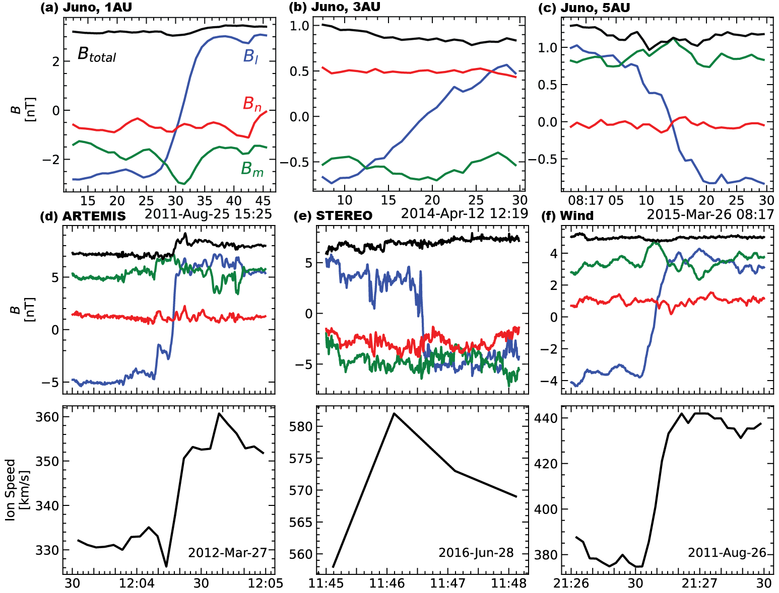
Introduction
Figure 1: Examples of IDs from ARTEMIS, STEREO, and Wind

Slide 3
Motivation
How do solar wind discontinuities evolve over radial distances from the Sun?
Juno during its five-year cruise phase (2011-2016) to Jupiter provides a unique opportunity!
=> What are the physical mechanisms behind their formation and evolution?

Slide 4
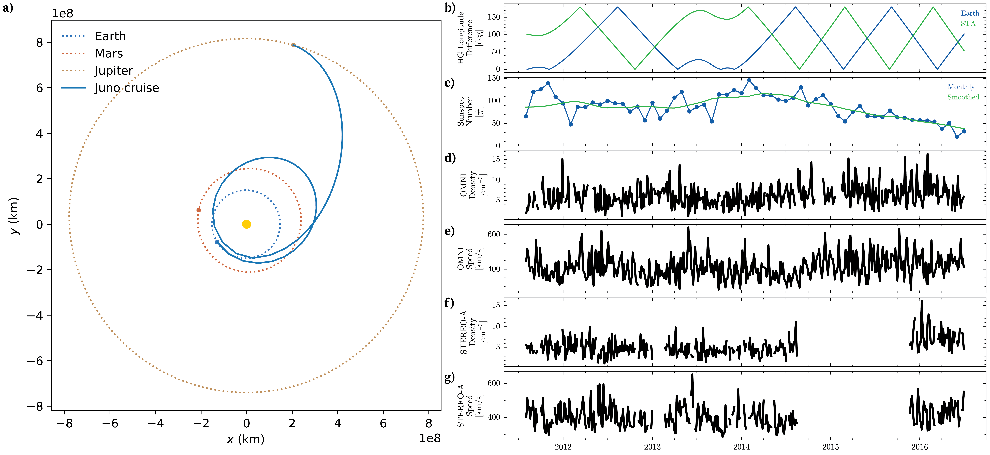
Overview
Figure 2: Overview. a, Juno’s orbit during its cruise phase (2011-2016). b, Difference in heliographic longitude between Juno and 1-AU missions. c, monthly and smoothed sunspot numbers. d-g, solar wind plasma density and speed from Near-Earth (OMNI) and STEREO-A missions.

Slide 5
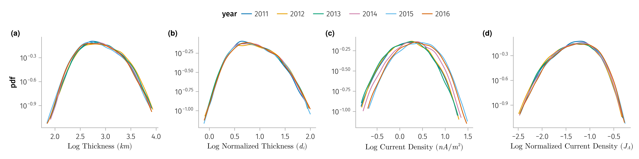
Temporal variations of SWDs
Figure 3: Distribution of various properties of IDs observed by Wind mission grouped by the year of observation. Panel (a) thickness, (b) normalized thickness, (c) current density, (d) normalized current density.

Slide 6
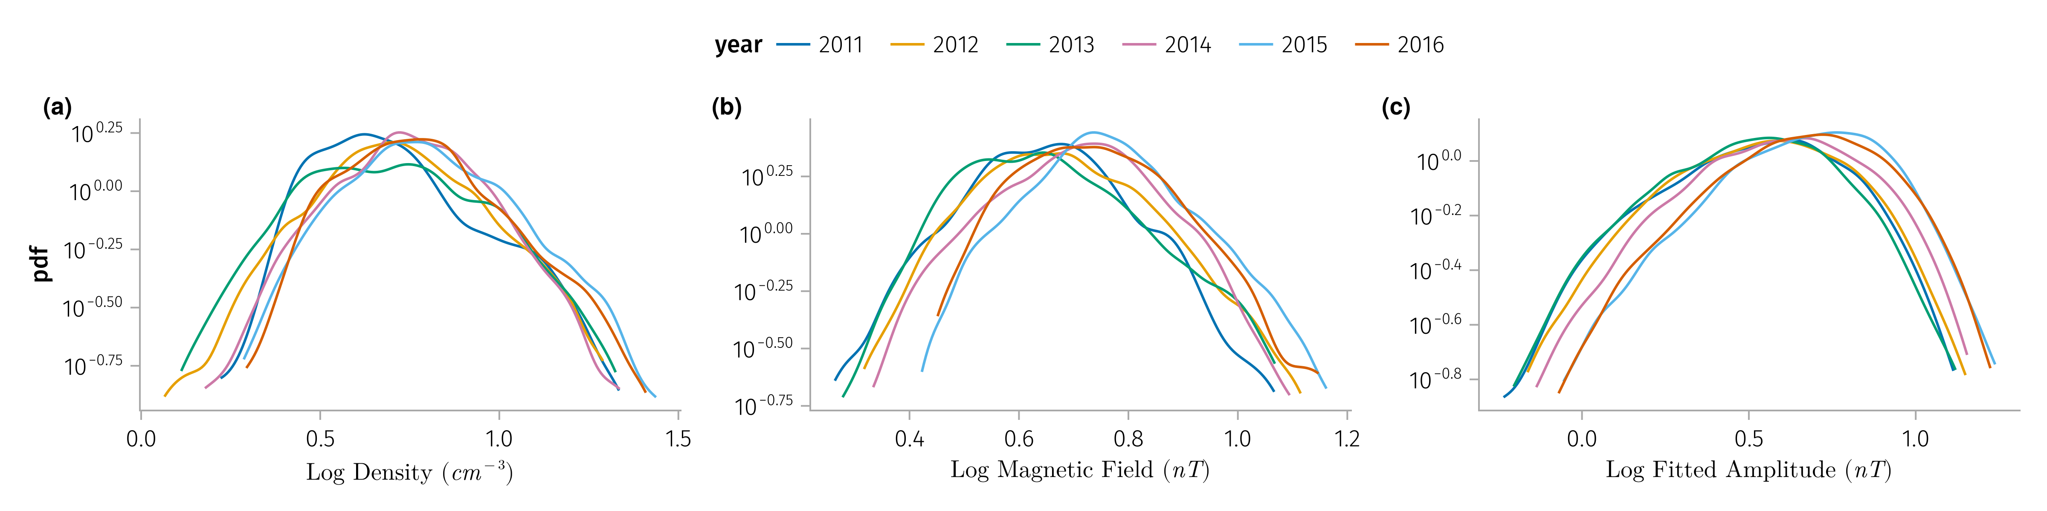
Figure 4: Solar wind parameters associated with the IDs observed by 1AU satellites (Wind, ARTEMIS and STEREO-A) grouped by the year of observation. Panel (a) solar wind density, (b) magnetic field, (c) fitted magnetic field $A$ in Equation 1.

Slide 7
Dataset
Mission | δt(B) | δt(plasma)
Juno | 1 Hz | 1 hour
ARTEMIS | 5 Hz | 0.25 Hz
WIND | 11 Hz | 1 Hz
STEREO | 8 Hz | 1 min

Slide 8
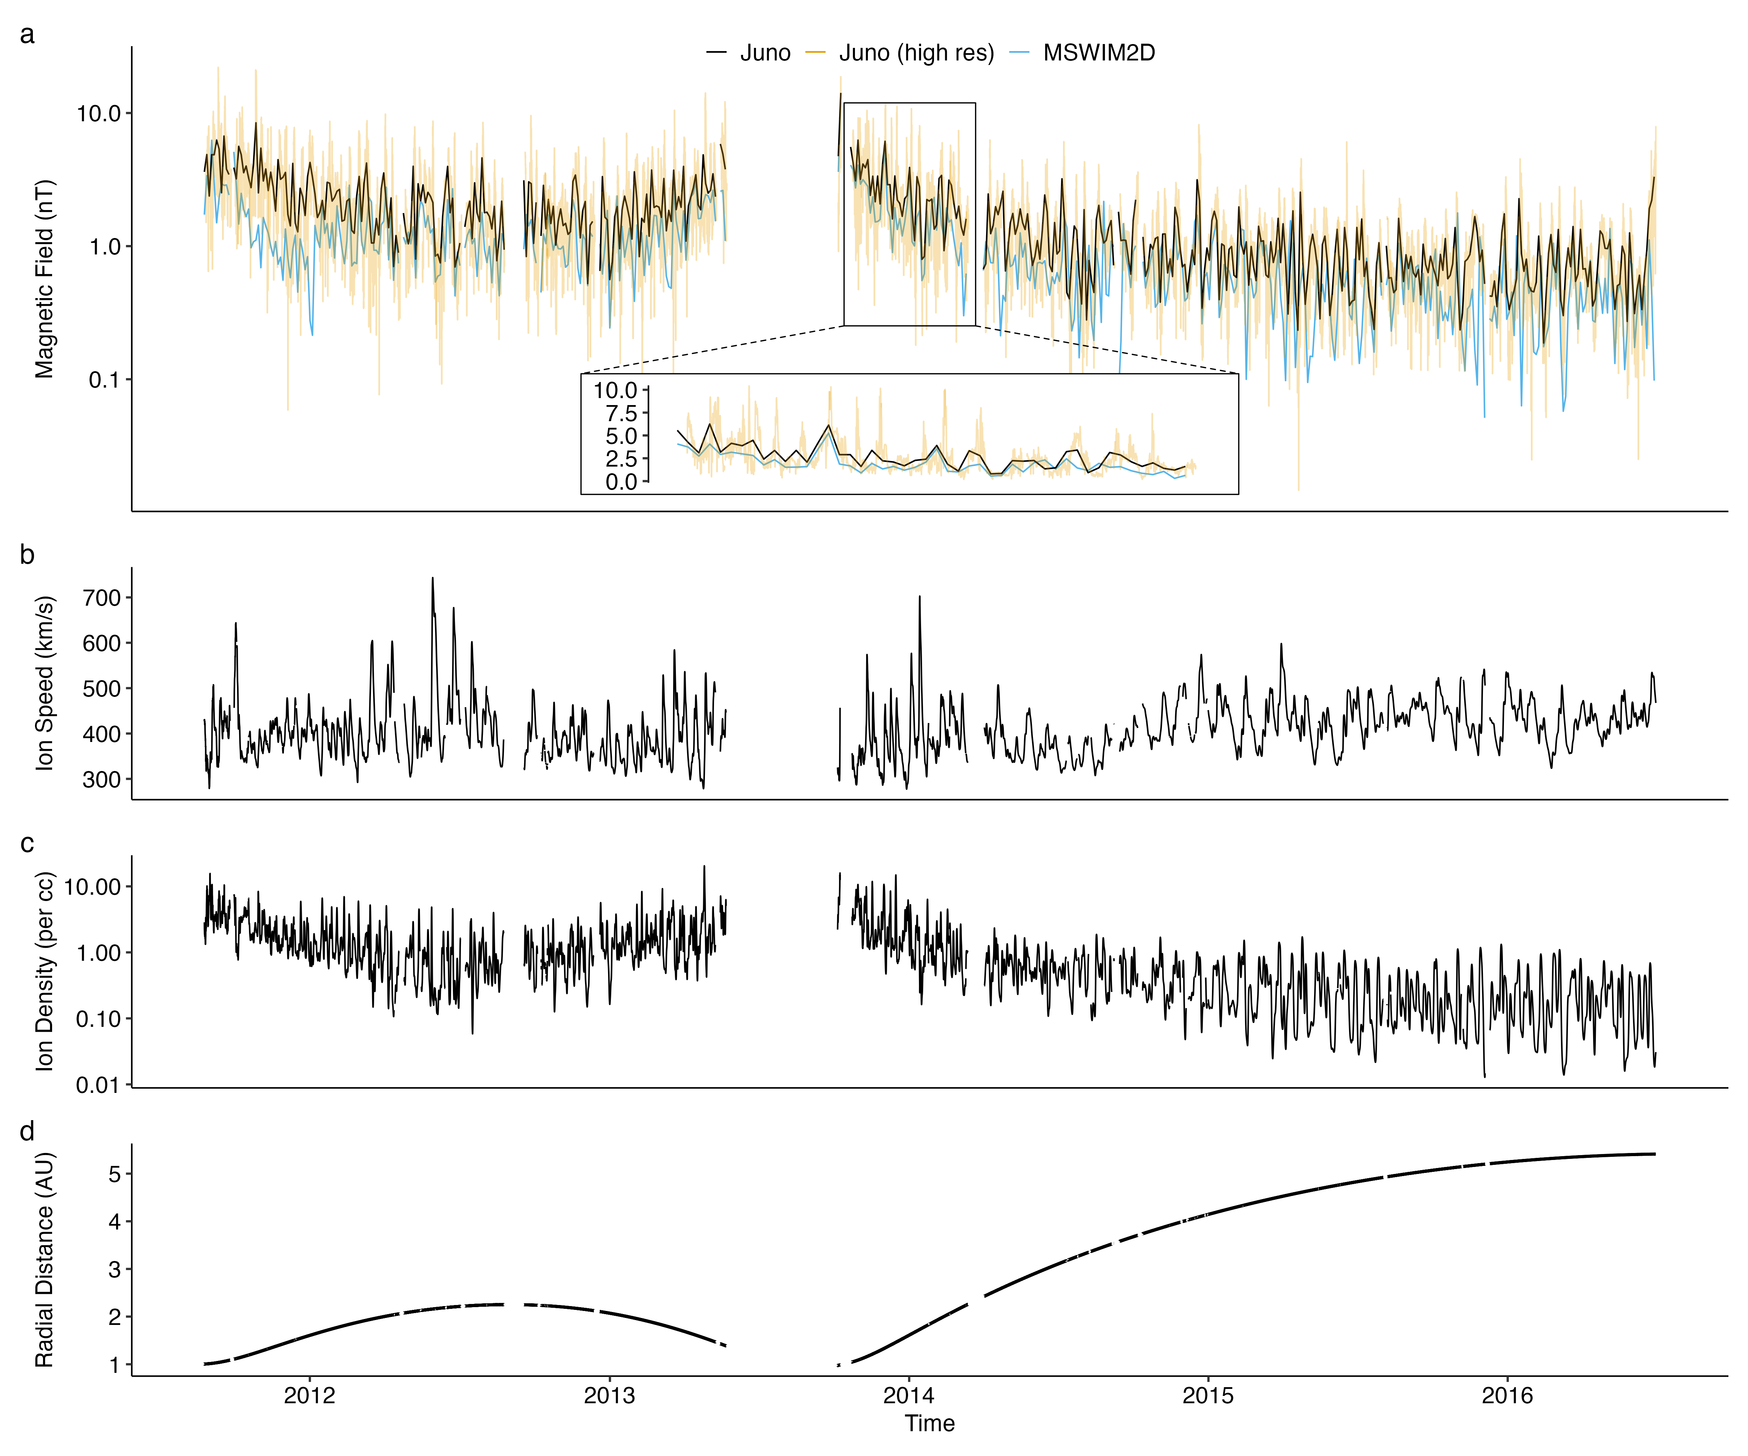
$$B\left(t;A,μ,σ,form=logistic\right)=A\left[1−\frac{1}{1+e^{α}}\right] \left(1\right)$$
Figure 5: a, Magnetic field magnitude from MSWIM2D and Juno. b-c, Plasma speed and density from MSWIM2D model. d, Juno radial distance from the Sun.

Slide 9
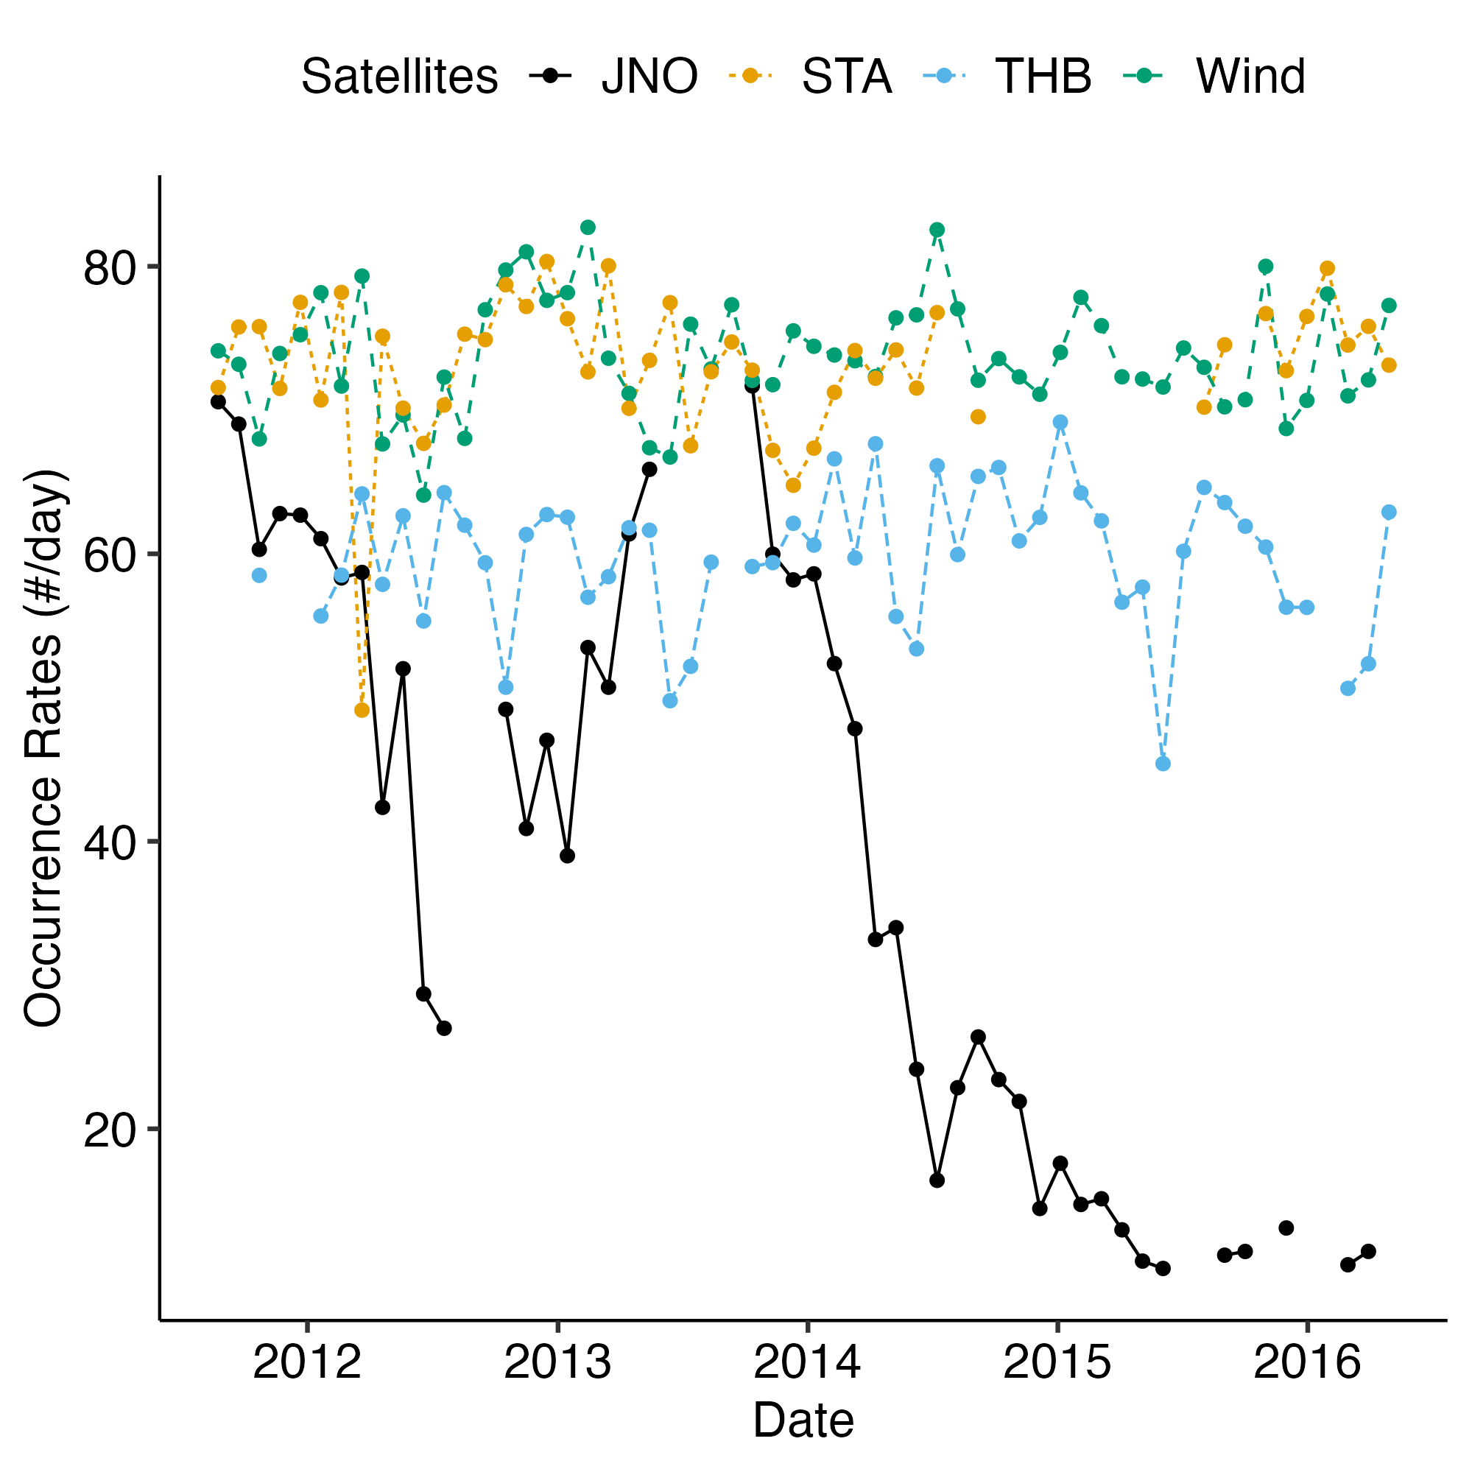
Results - Occurrence rate
Figure 6: The number of discontinuities measured by Juno per day coincides with the discontinuity number measured by STEREO, WIND, and ARTEMIS, when Juno is around $1$ AU. This number (occurrence rate) decreases with distance (with time after $∼2013$), as Juno moves from $1$ AU to $5$ AU. We will use the similar comparison for discontinuity characteristics and occurrence rate derived for PSP and Juno. The radial distance of Juno for 2011-2016 is shown in Figure 5.

Slide 10
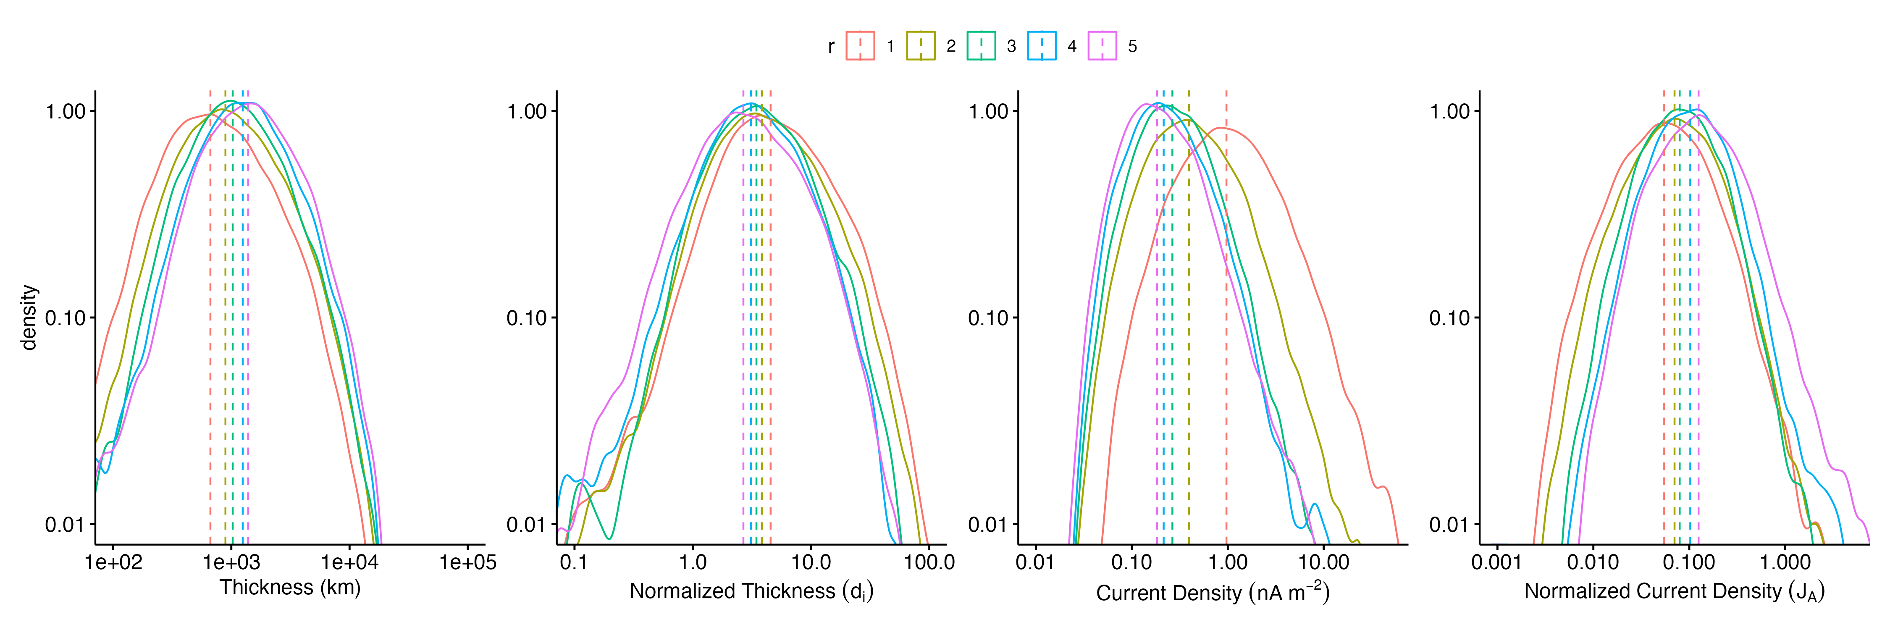
Results - Current density and thickness
Figure 7: Distribution of various properties of IDs observed by Juno grouped by the radial distance from the Sun. Panel (a) thickness, (b) normalized thickness, (c) current density, (d) normalized current density.

